Slide 1
Intracellular recordings in a weakly electric fish
Patrick Weygoldt, Alexander Wendt und Kathrin Root

Slide 2
Outline
Introduction:
Apteronotus leptorhynchus
Electric organ
Brain and nerve cells
Goal
Methods
Results
Baseline
Response to chirps/stimulus
Response to beat
Discussion

Slide 3
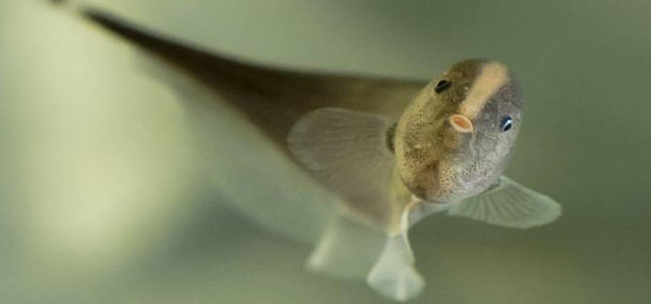
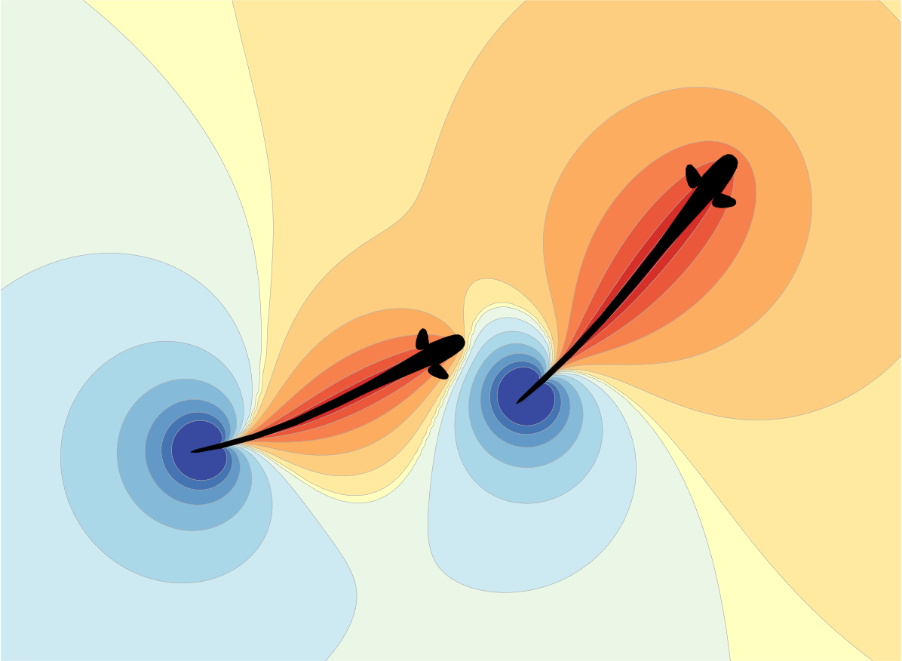
Introduction - Apteronotus leptorhynchus
Occurrence: Freshwaters in South America
Communicate via self-generated electric field
https://latina-press.com/news/250508-bettgefluester-von-messerfischen-in-freier-wildbahn-belauscht/
https://bendalab.github.io/pubs/Benda2020-ElectrosensoryWorlds.pdf

Slide 4
Introduction – Electric organ
Electric organ:
stretches over the entire body and consists of electrocytes
The electric organ discharge (EOD) runs continuously
With the EOD, the animals can perceive objects and orient themselves in the environment
Frequency of EOD is sexually dimorphic:
Male EODf: 850 – 1050 Hz
Female EODf: 650 – 850 Hz

Slide 5
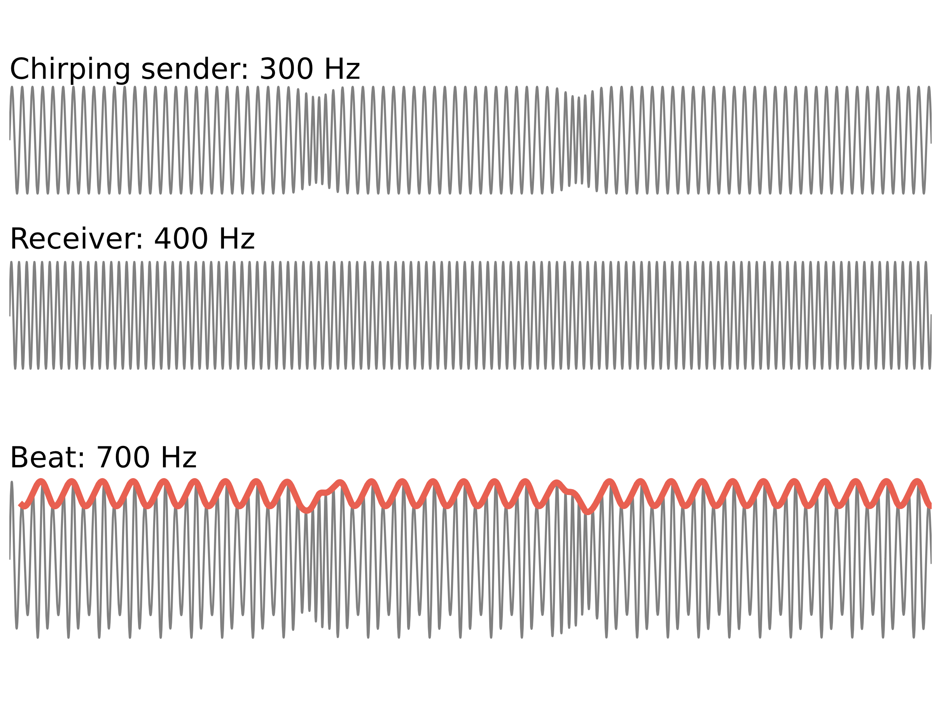
Introduction – EOD Frequencies

Slide 6
Introduction – Electric Organ – P-Units
P-units = electrocytes
Spontaneous active
React to their own electric field
Project into the electrosensory lateral line lobe (ELL)

Slide 7
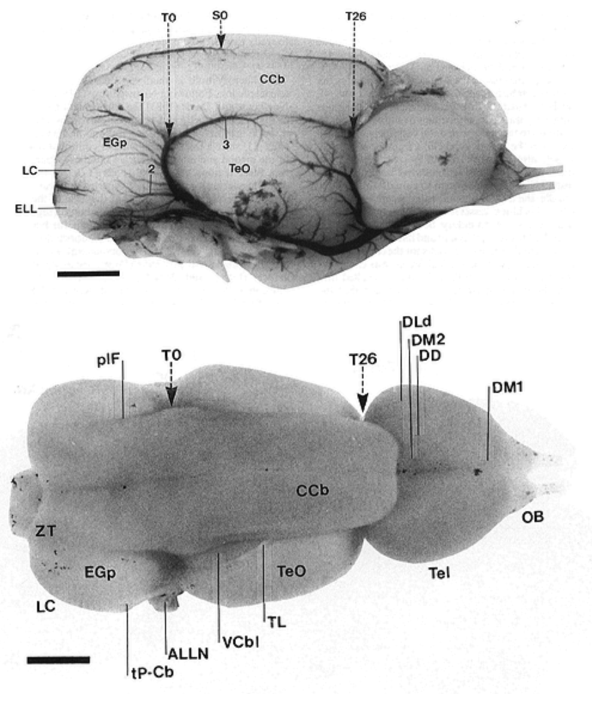
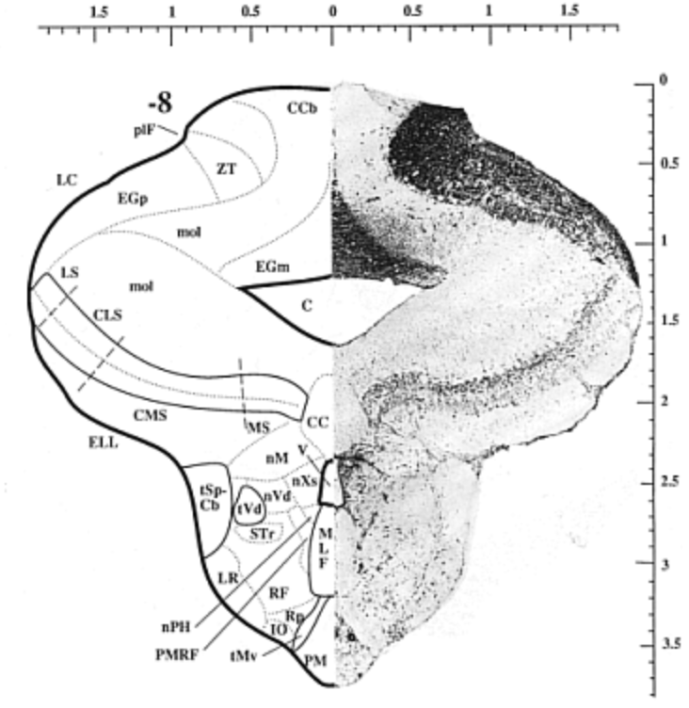
Introduction – Brain regions

Slide 8
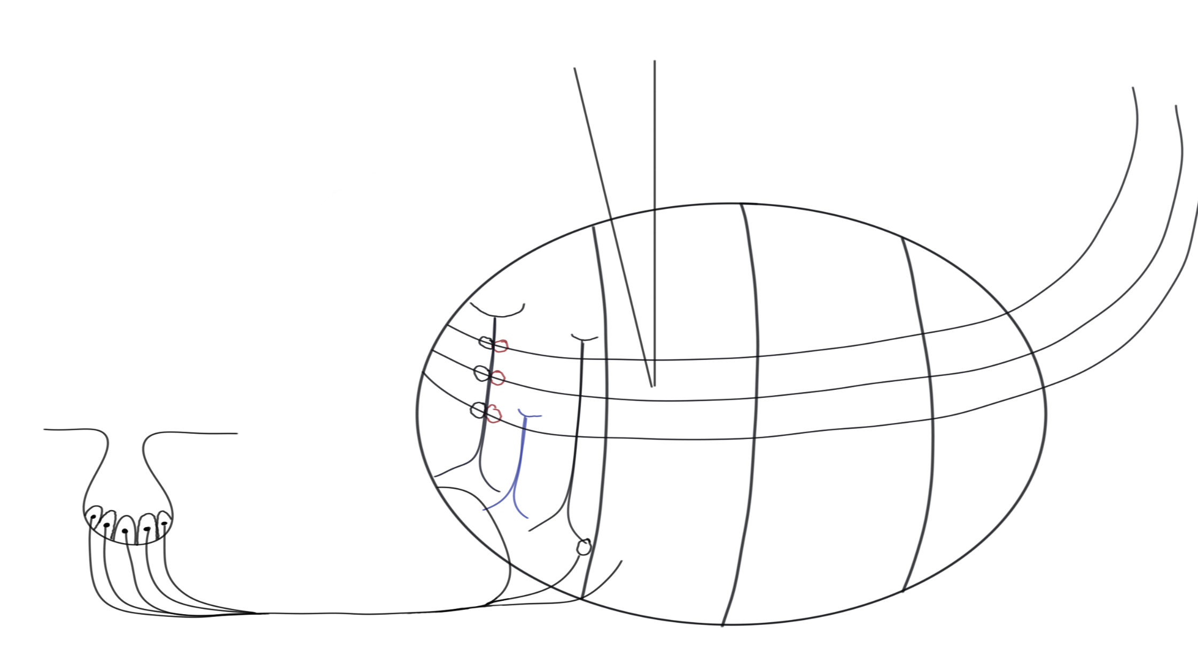
Introduction – ELL pyramidal cells
Electrode
CLS
CMS
LS
MS
Superficial pyramidal cell
Deep pyramidal cell

Slide 9
Goal
Find ELL pyramidal cell
Identify type of pyramidal cell
Does pyramidal cell response to the beat or chirp?

Slide 10

Methods - Aufbau
DAQ
relacs
Stimulus isolator
Local EOD
Membrane potential
Multiplier addition
Global EOD
Graphite electrode

Slide 11
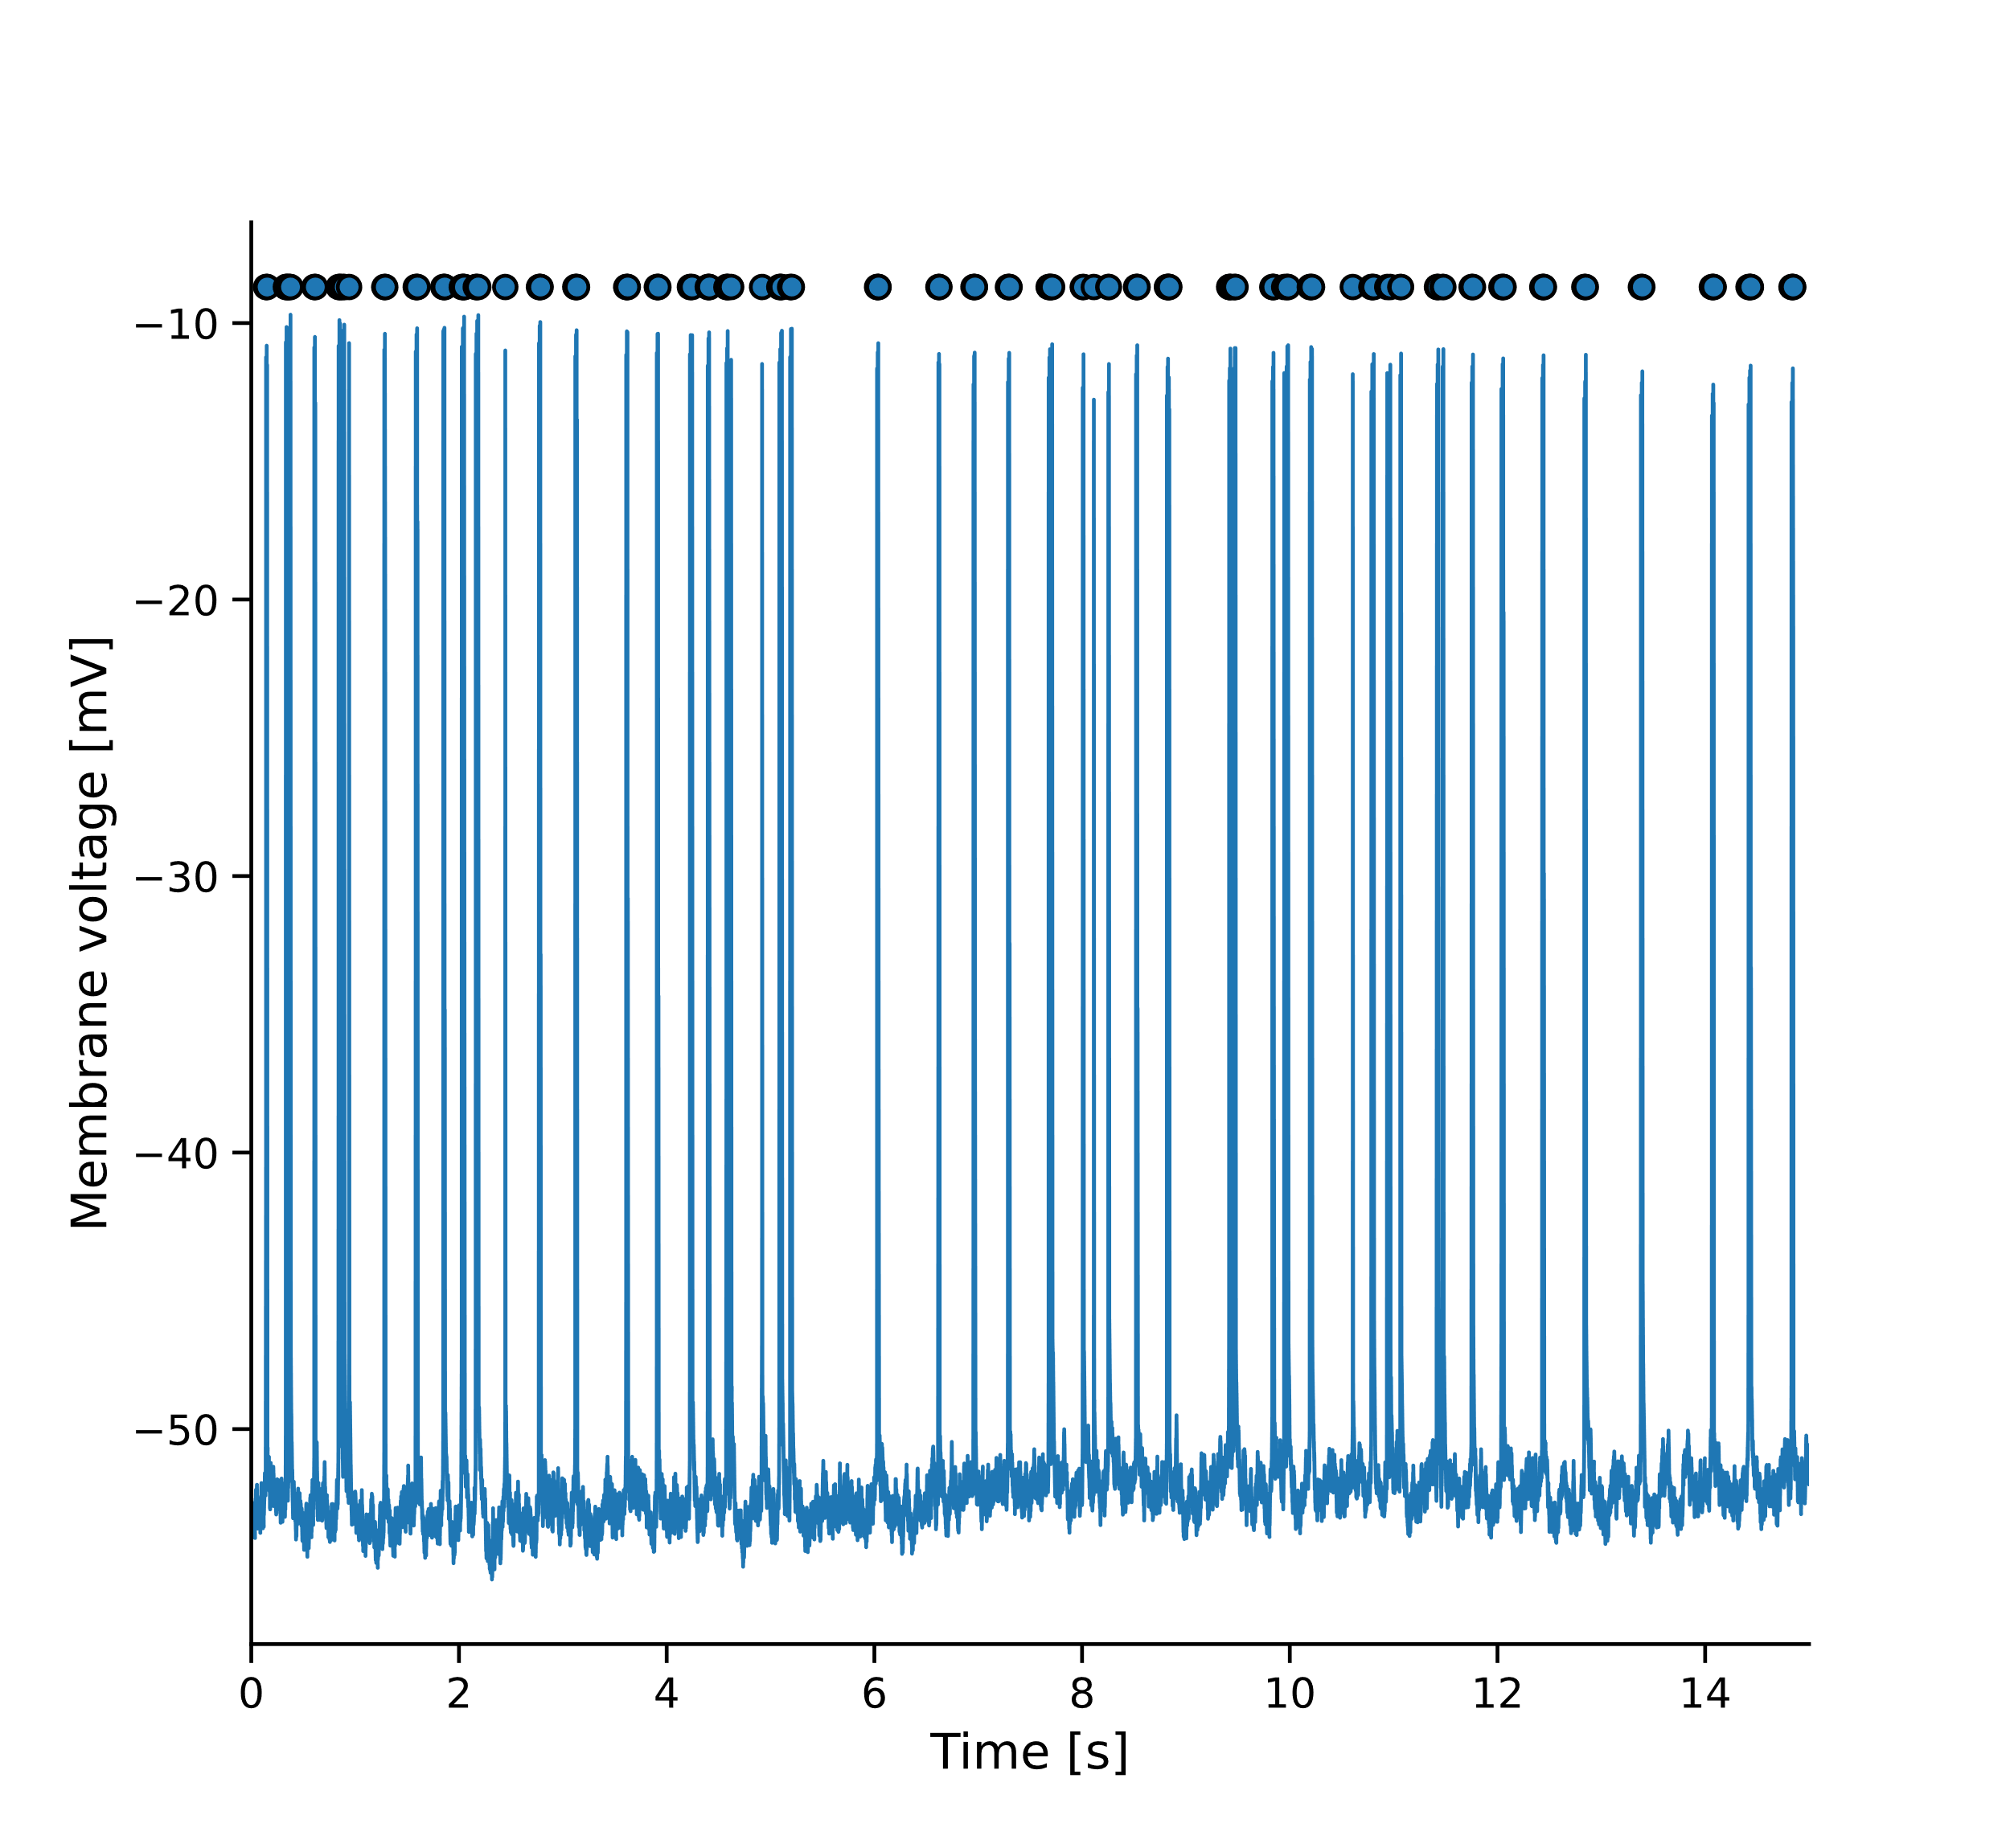
Results – Baseline analysis
Baseline activity

Slide 12
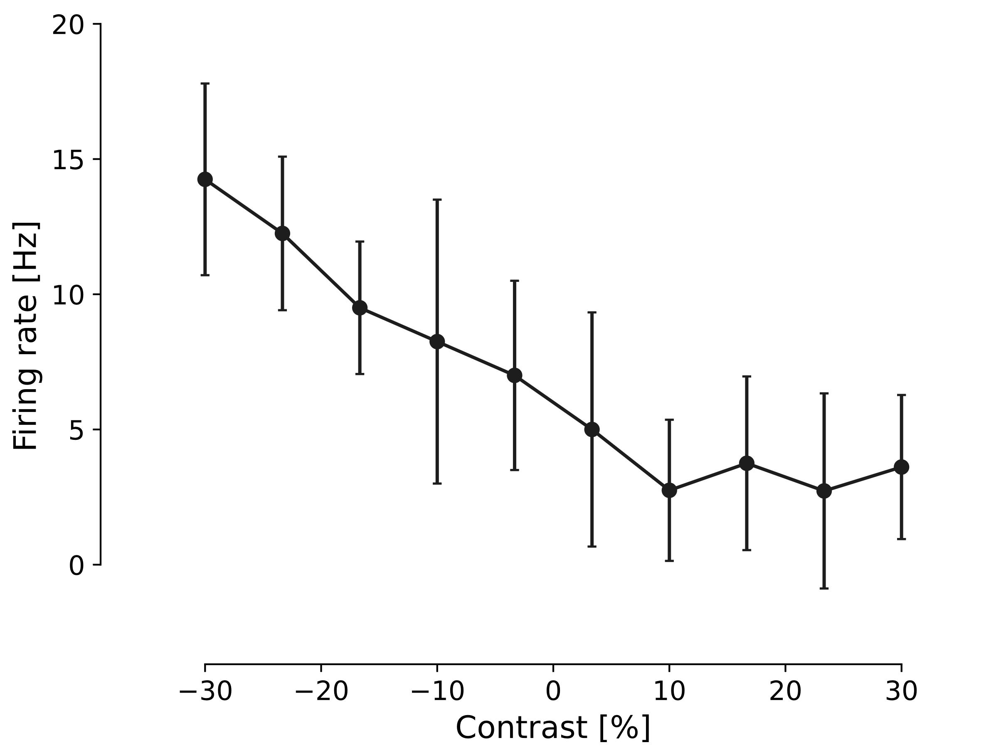
Results – Baseline analysis
FI-curve

